Slide 1
Ensemble Learning for Vietnamese Scene Text Spotting in Urban Environments
Hieu Nguyen, Cong-Hoang Ta, Phuong-Thuy Le-Nguyen
Minh-Triet Tran, Trung-Nghia Le
Faculty of Information Technology, University of Science, VNU-HCM, Vietnam Vietnam National University, Ho Chi Minh City, Vietnam
December 24, 2023
Notes:
Good morning, ladies and gentlemen. My name is Hieu Nguyen, I’m from Vietnam National University in Ho Chi Minh City. It’s my pleasure to be here to talk about our research work: Ensemble Learning for Vietnamese Scene Text Spotting in Urban Environments.

Slide 2
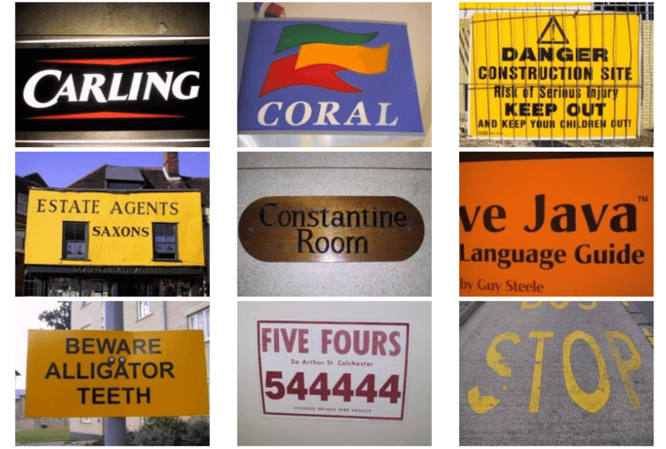
Introduction
What is Vietnamese Scene Text Spotting?
Highly formidable task in computer vision
precise localization
identification of text sequences
within real-world contexts
Crucial applications
key entities recognition
autonomous driving
intelligent navigation
Some of the natural scene text images
(ICDAR 2015 dataset).

Slide 3
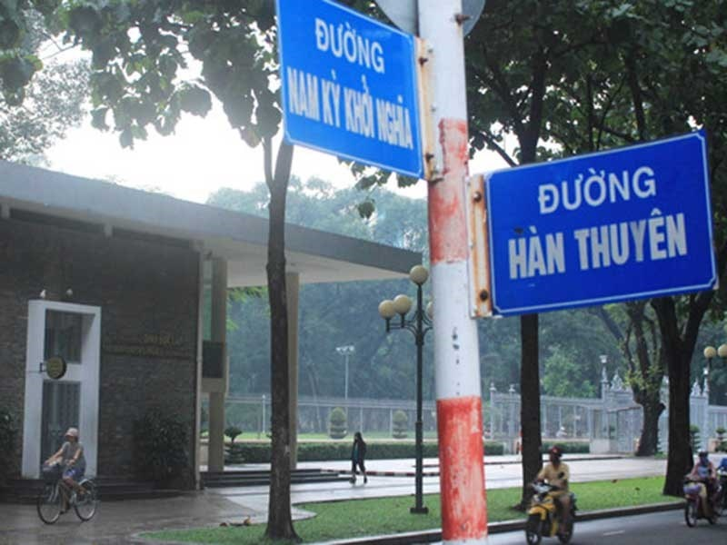
Introduction
What is Vietnamese Scene Text Spotting?
Scene texts in bustling city contexts
occluded, either partially or entirely
due to the presence of diverse surrounding objects: trees, towers, traffic signs, etc.
The variability in lighting conditions
weather fluctuations
low contrast scenarios
caused by background reflections
Various challenges, such as obscured by trees and perspective-shifted.

Slide 4
Introduction
What is Vietnamese Scene Text Spotting?
Rich set of characters and diacritics
Poses significant challenges
Some Vietnamese characters, especially when accompanied by diacritics, exhibit visual similarities
can lead to confusion
ă, â, á, à
ô, ó, ơ, ồ
e, ê, ế

Slide 5
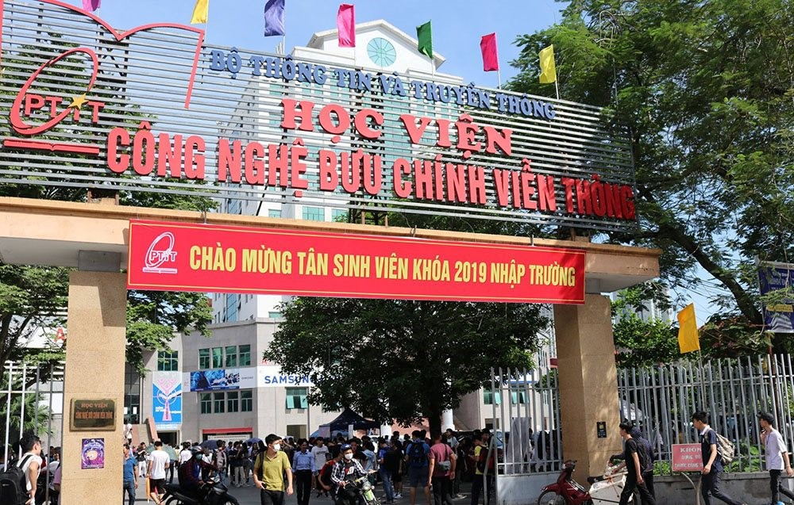
Introduction
Why Vietnamese?
Few tools mainly focus on Vietnamese
scene text
Easier to encounter limitations when detecting and recognizing Vietnamese scene text.
Result from Google Lens (Google image search)

Slide 6
Related Work
Two typically approaches: two-stage and end-to-end
Two-stage approach: detection, recognition
Detection: DB/DB++, SAST, EAST, etc.
Recognition: SPIN, SRN, SVTR, ABINet, etc.
End-to-end approach: merging detection and recognition into a unified system
PGNet
SwinTextSpotter

Slide 7
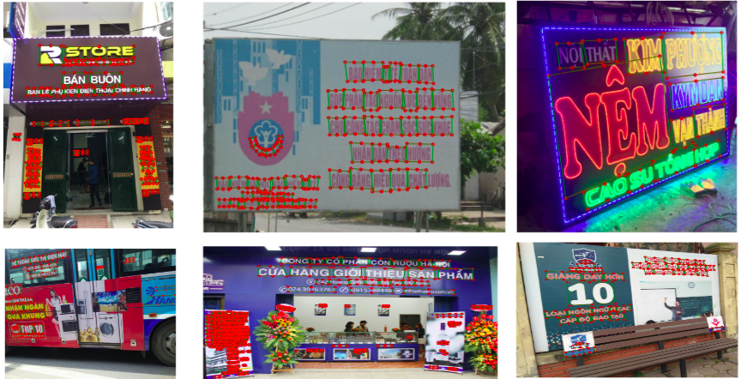
Related Work
Benchmark dataset for Vietnamese scene text spotting
Nguyen et al. contributed VinText dataset - a challenging benchmark for Vietnamese scene text spotting.

Slide 8
Proposed Method
Ensemble learning framework
Existing approaches:
predominantly rely on individual models
each method varying degrees of success across different subsets of images
Ensemble learning framework
integrate results from individual models
both two-stage and end-to-end approaches
improve the performance of scene text spotting.

Slide 9
Proposed Method
Ensemble learning framework
Workflow of the proposed ensemble learning framework for Vietnamese scene text spotting.

Slide 10
Proposed Method
Meta-model:
Merging non-overlapping text boxes:
Where:
Pair of non-overlapping text boxes
( ) are defined by:
Combine non-overlapping text boxes of different results to form :
is prediction result of i^{th} base model, which is list of text boxes:
are text boxes consisting of the coordinates of 4 points.
is the coordinates of a point in Oxy, which is one of 4 points of a text box (B)

Slide 11
Proposed Method
Meta-model:
Merging overlapping text boxes:
Where:
Intersection over Union (IoU):
Combine two overlapping text boxes by IoU:
is prediction result of i^{th} base model, which is list of text boxes:
are text boxes consisting of the coordinates of 4 points.
is the coordinates of a point in Oxy, which is one of 4 points of a text box (B)
is the area of the text box

Slide 12
Experiments
Settings:
Dataset: VinText dataset (a recently proposed Vietnamese text dataset)
56K text instances;
2,000 images, which consists of 1,200 training images, 500 testing images, and 300 unseen test images
Performed on Google Colab
GPU T4
13GB of RAM.
Number of epoch:
Recognition, End-to-end: 30 epochs
Detection: 20 epochs
Learning rate:
Recognition, End-to-end:
Detection:

Slide 13
Experiments
Metrics:
Detection task
Precision
Recall
F-measure
Recognition task
Character Accuracy
End-to-end and ensemble model
F-measure
Character Accuracy

Slide 14
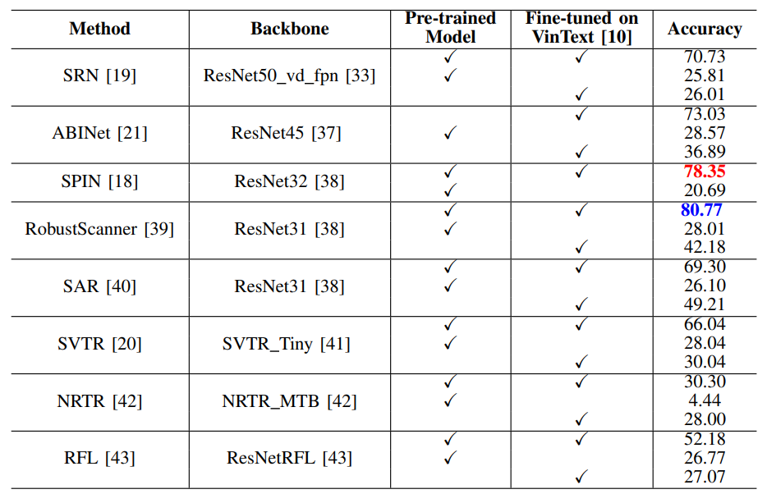
Experiments
Results:
Recognition methods
Result on VinText
Contain:
Train from scratch
Use pre-trained model only
Use Pre-trained model and train on VinText
1st and 2nd places are shown in
blue and red respectively

Slide 15
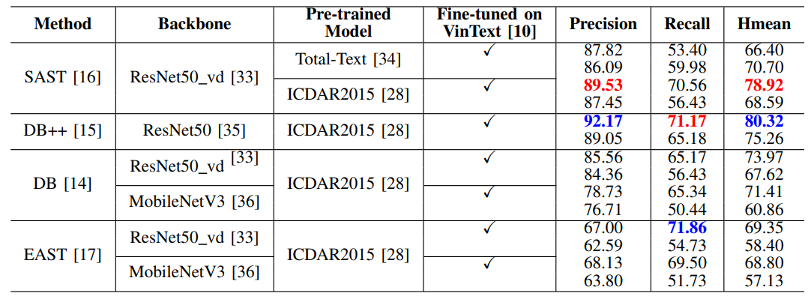
Experiments
Results:
Detection methods
Result on VinText
Contain:
Use pre-trained model only
Use Pre-trained model and train on VinText
1st and 2nd places are shown in blue and red respectively

Slide 16
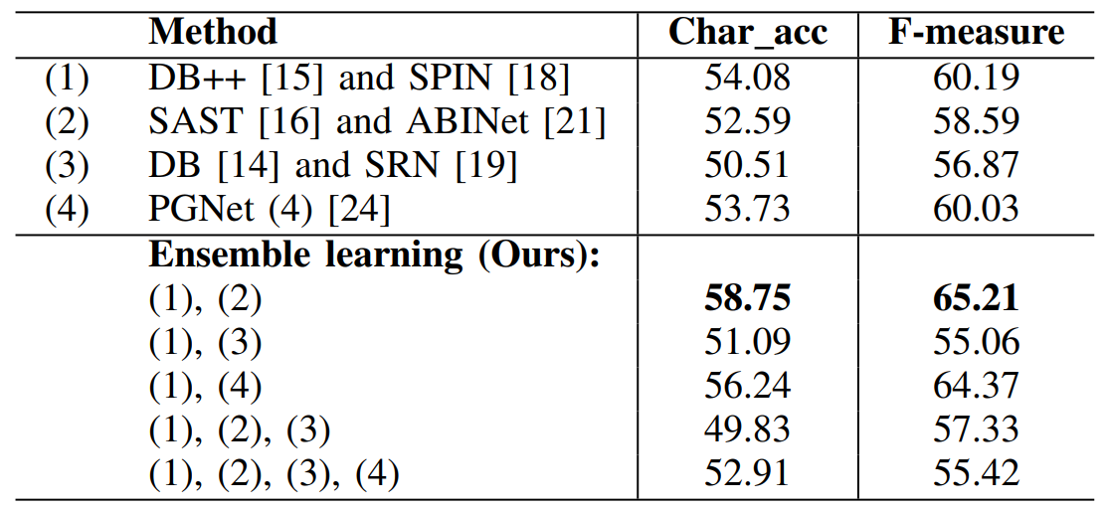
Experiments
Results:
Scene text spotting results
Result on VinText
Boosting CA, F-measure
up to 4-5%

Slide 17
Experiments
Visualization:
DB++ and SPIN:
Ensemble method:

Slide 18
Conclusion
Proposed an ensemble learning framework for Vietnamese scene text spotting in urban environments
The proposed technique demonstrates effectiveness of combining the strengths of different models
Drawbacks!
increase in computational complexity due to the integration of multiple models
Future research:
aim to address these challenges by focusing on enhancing spelling accuracy during word recognition
reduce computational complexity of the ensemble model

Slide 19
Thank you for listening! Question?
Q & A

Slide 20
References
[1] Kavitha, D., and V. Radha. "Texnet: A deep convolutional neural network model to recognize text in natural scene images." Journal of Engineering Science and Technology 16.2 (2021): 1782-1799.[2] J. Zhang, Z. Fang, Y. Zhang, and D. Song. Zero knowledge proofs for decision tree predictions and accuracy. In Proceedings of the 2020 ACM SIGSAC Conference on Computer and Communications Security, pages 2039–2053, 2020
[2] N. Nguyen, T. Nguyen, V. Tran, M.-T. Tran, T. D. Ngo, T. H. Nguyen, and M. Hoai, “Dictionary-guided scene text recognition,” in CVPR, pp. 7383–7392, 2021.

